Slide 1
UI Design Document
1. Screenshot: Login UI
2. Screenshot: Dashboard UI
3. Sketch: Design Concept

Slide 2
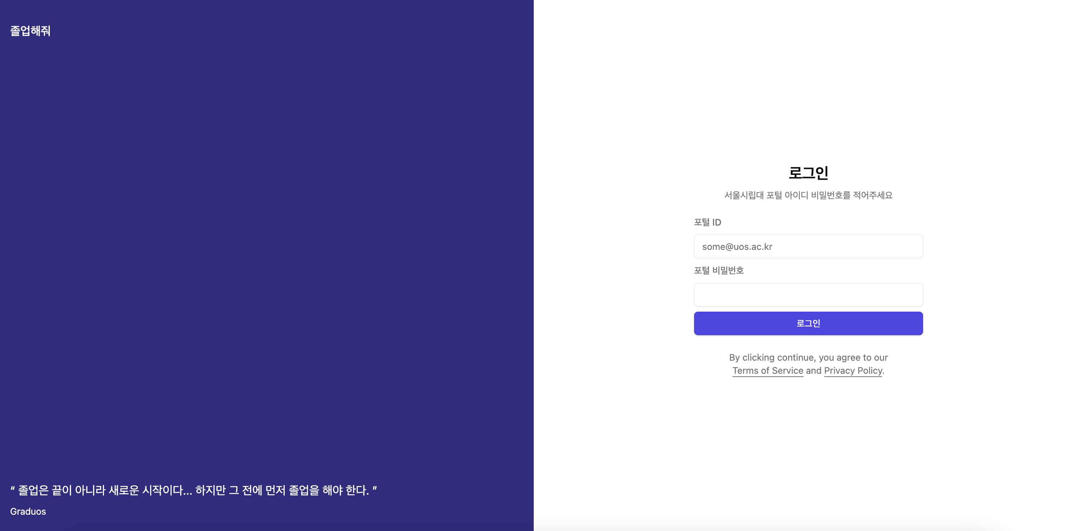
1. Screenshot: Login UI

Slide 3
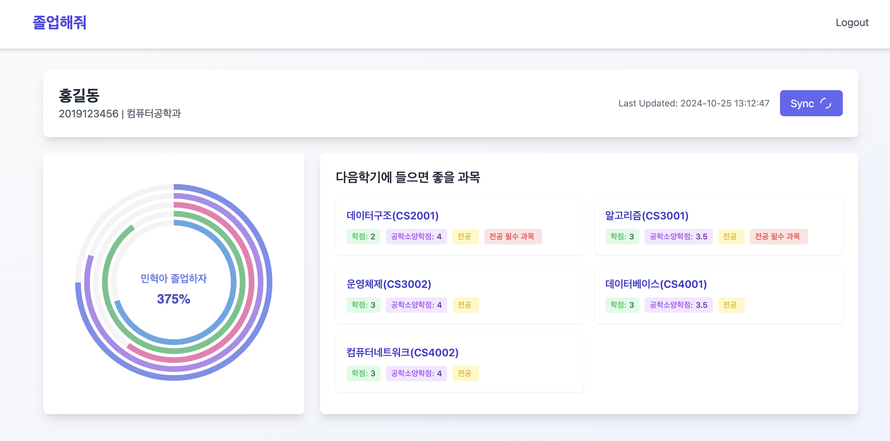
2. Screenshot: User’s Dashboard UI

Slide 4
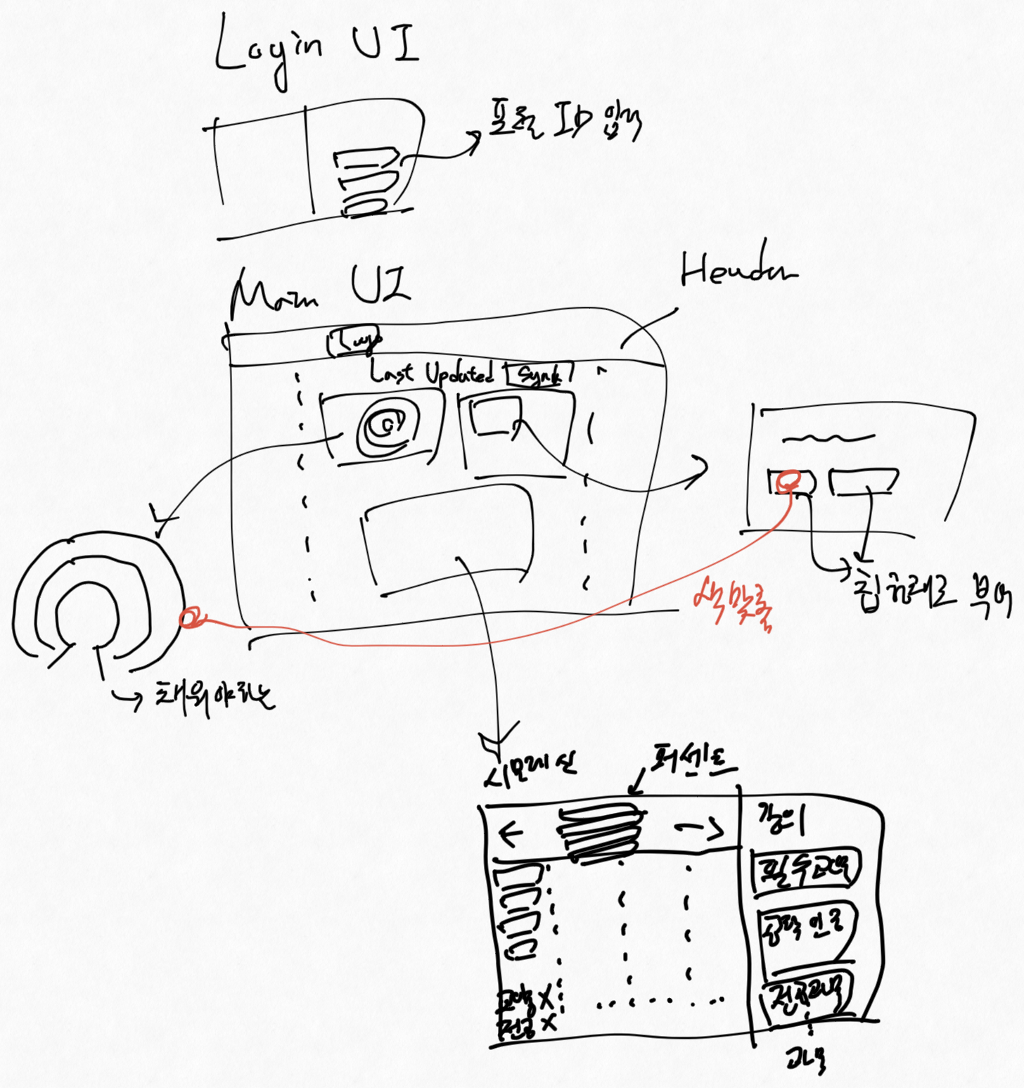
3. Sketch: Design Concept

